Slide 1

COMP 3962 Cloud Computing Platforms
Lab 6

Slide 2



Agenda
Elastic Beanstalk
Full stack
JS Review
ES6 Part 1

Slide 3

How to serve your website?

Slide 4
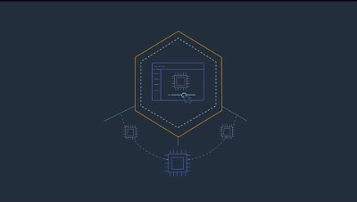
Another way to serve: AWS Beanstalk

Slide 5
AWS Elastic Beanstalk
is an easy-to-use service for deploying and scaling web applications and services developed with Java, .NET, PHP, Node.js, Python, Ruby, Go, and Docker on familiar servers such as Apache, Nginx, Passenger, and IIS.

Slide 6

How to use?
You can simply upload your code and Elastic Beanstalk automatically handles the deployment, from capacity provisioning, load balancing, auto-scaling to application health monitoring. At the same time, you retain full control over the AWS resources powering your application and can access the underlying resources at any time.

Slide 7

Cost
There is no additional charge for Elastic Beanstalk - you pay only for the AWS resources needed to store and run your applications.

Slide 8

Stack?
Stack is not only about pancakes,
We also have web stack.

Slide 9
Discussion
Describe the components of a scalable, distributed web stack

Slide 10
Scalability
Facebook Story (Wikipedia)
2003 450 visitors and 22,000 photo-views
2008 100 Million monthly active users
2016 1.86 Billion monthly active users
2019 2.1 Billion monthly active users
2021 2.89 Billion monthly active users
Facebook Timeline

Slide 11
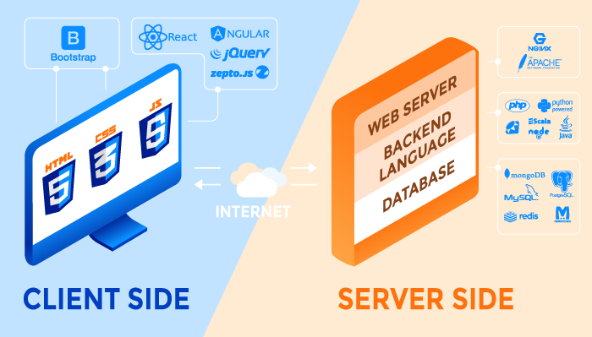
Distribution

Slide 12
Client Side (Front End)
FE Programing Language
Browser/Mobile App
Scripting language
HTML
JavaScript
CSS
Browser
IE / Edge
Chrome
Safari
Etc.

Slide 13
Server Side (Back End)
Database
Web Server
BE Programing
Language
All about data
Apache HTTP Server
IIS
NGINX
Express.js with node.js
Java
PHP
Python
ETC

Slide 14
Server Side (Back End) – Cond.
Operating
Systems (OS)
Load
Balancer
Application
Server
Windows
Linux/Unix
MacOS
much more
Software
HAProxy
Elastic Load Balancer
Nginx
And more
Hardware
JBoss (open-source)
Glassfish (Sun ->Oracle)
Weblogic (Oracle)
Websphere (IBM)

Slide 15

Load Balancer
Between Client and Server
Software or Hardware?

Slide 16
Summary
Category | Where | Components
Front End | Client side | Front End (programming) language Browser (or Mobile app)
Back End | Server side | Web Server Database Backend programming language Load balancer OS Application Server

Slide 17

JavaScript Basics
Here is a brief (but incomplete) recap of some JavaScript Basics
This should only serve as a refresher

Slide 18
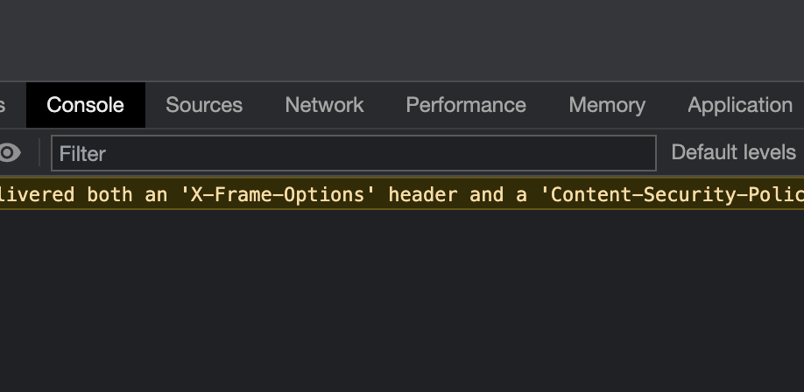
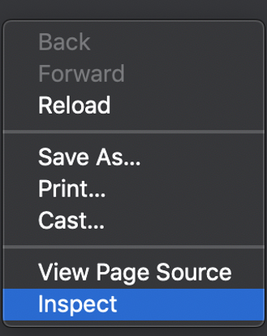
Console

Slide 19
Variables
In older version of JS | Since ES6 (AKA, ES2015)
var | let and const
Comments
One-line comment | Comments for multiple lines
// this is a comment let a = 5 ; // another comment | /* Here, we have a comment over lines */

Slide 20
In .html file
<script>
// your JS code goes here
</script>

Slide 21
In external .js file
Why?
If you want to use the same JavaScript on several web pages, consider storing the code in a separate external file.
Saving JavaScript in a separate external file will make your web page less cluttered more readable
You can then include a reference to the external file on each web page that you want to use the JS.
Use the .js extension when naming the file
Use following tag to link to the external file:
<script type="text/javascript" src="myScript.js" ></script>
<script type="text/javascript" src="myScript.js" />

Slide 22
Numbers
5 //5
2.1 + 5 //7.1
2 + 10 -19 +4-90+1 //-92
(10/5)*4 -20 //-12
102 % 5 // 2

Slide 23
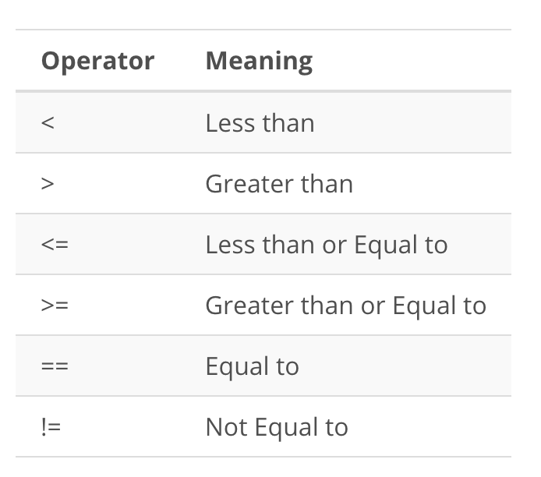
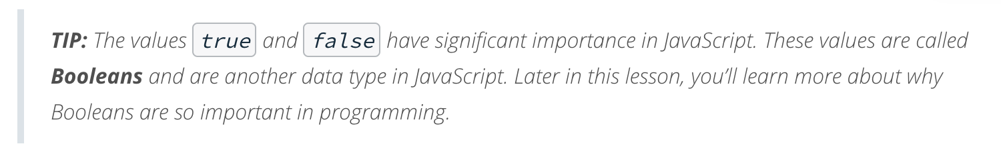
Comparing numbers
3 > 7 //false
3 < 7 //true
3 == 7 //false

Slide 24
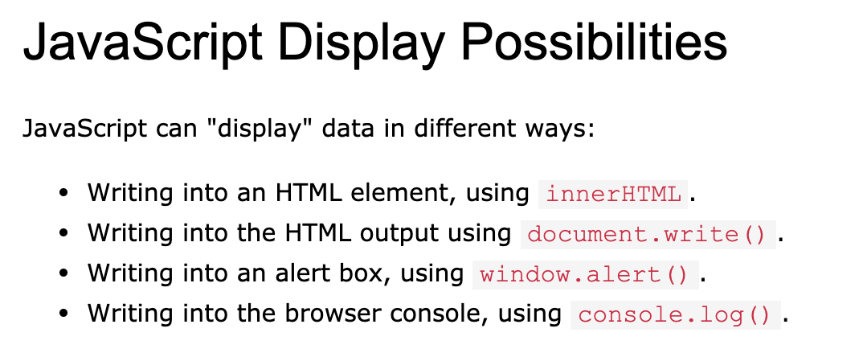
Basic output
How to print with JS?

Slide 25
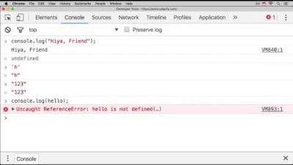
String

Slide 26
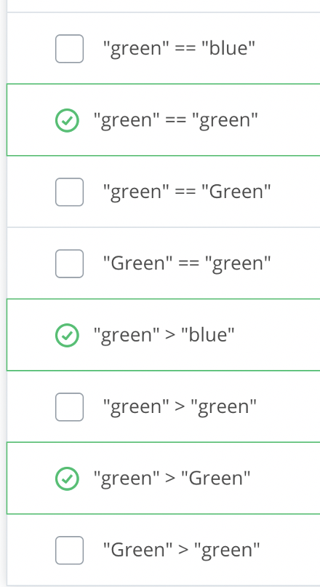
More about string
String concatenation
"hello " + "world", "hi + 5 *2", "hi " + 5*2
String index
"abc"[1] // ‘b’
Escaping strings
"The man whispered, \"please speak to me.\""
Comparing strings:

Slide 27
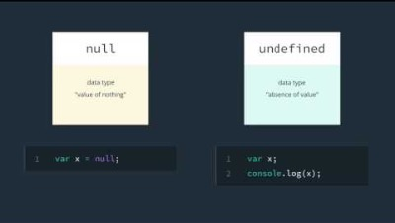
Null, Undefined, and NaN

Slide 28
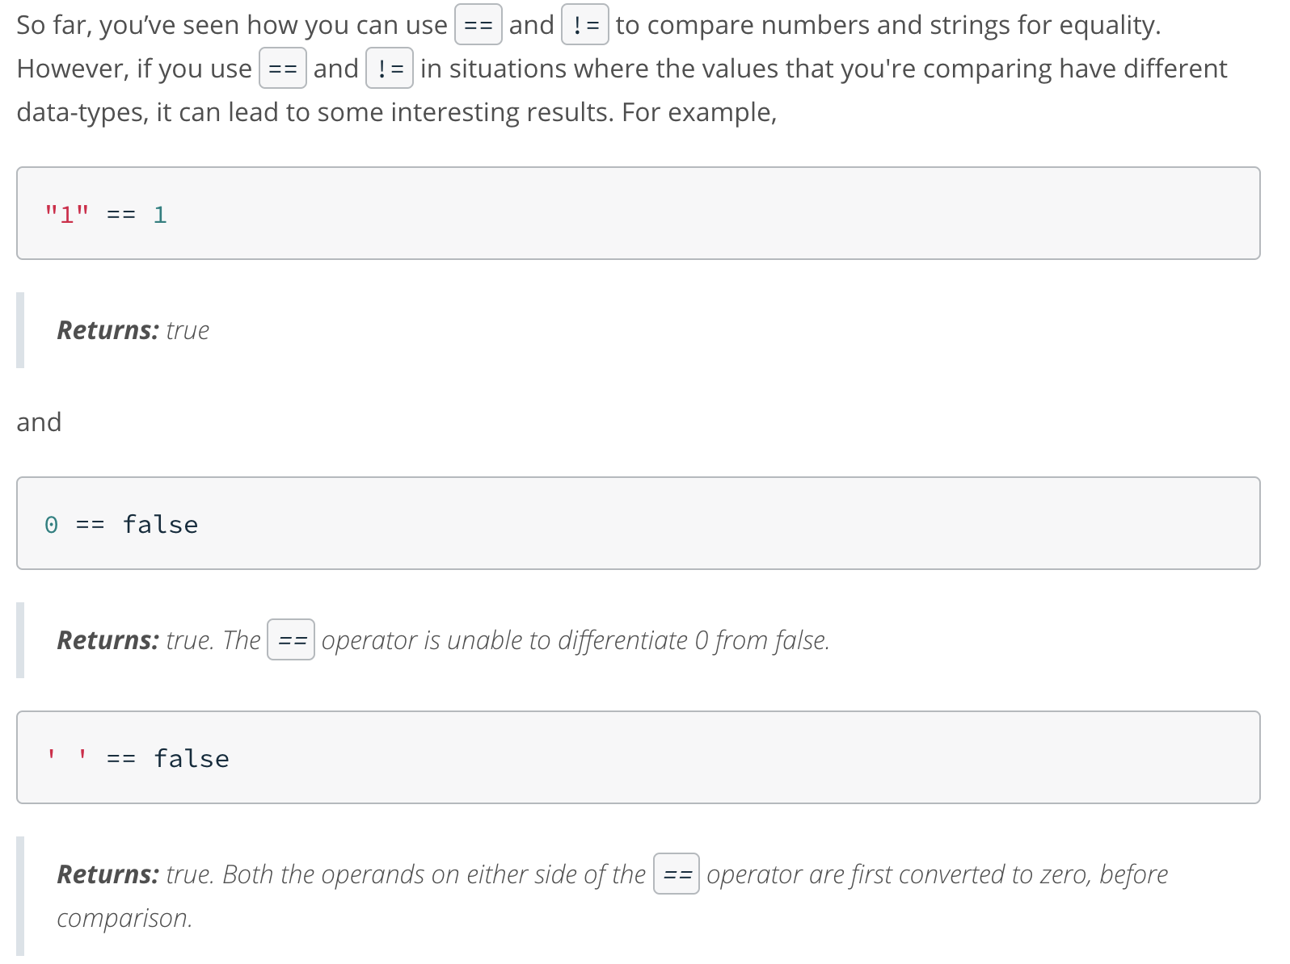

Equality

Slide 29
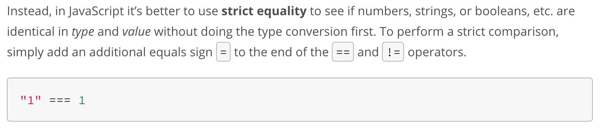
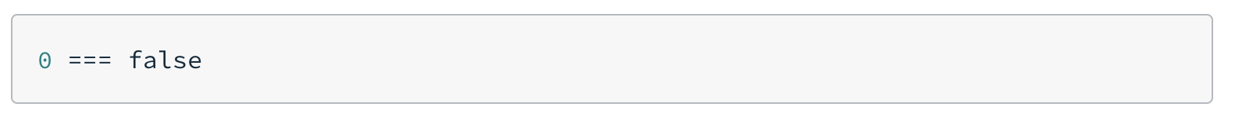
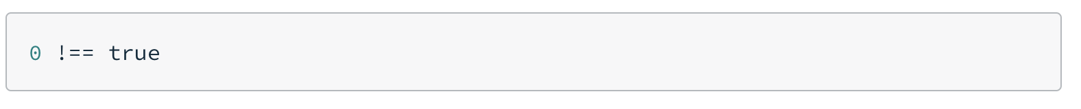
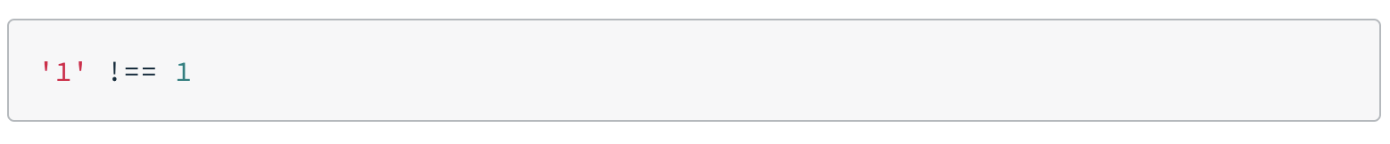
Strict Equality

Slide 30
The DOM tree
<!DOCTYPE HTML>
<html lang="en">
<head>
<meta charset="utf-8">
<title>San Joaquin Valley Town Hall</title>
</head>
<body>
<h1>San Joaquin Valley Town Hall</h1>
<p>Welcome to Town Hall. We have some fascinating speakers this season.
</p>
<h2>Our 2021-2022 Lineup of Speakers</h2>
<ul>
<li>Jeffrey Harrison</li>
<li>Andrew Ross Sorkin</li>
<li>Amy Chua</li>
</ul>
<p>Contact us by phone at 559-555-1212 to get tickets.</p>
</body>
Document Object Model

Slide 31
The DOM for the web page

Slide 32
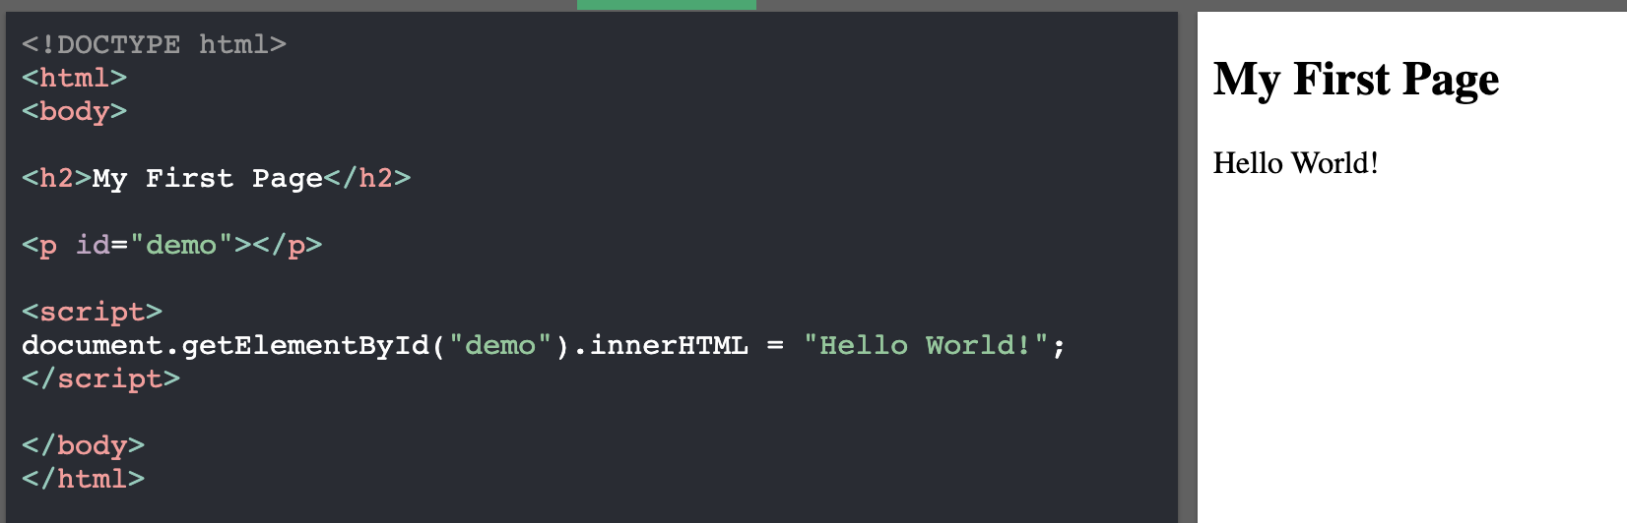
JS works with dom tree
document.getElementById("demo");
Demo: https://www.w3schools.com/js/tryit.asp?filename=tryjs_dom_method

Slide 33
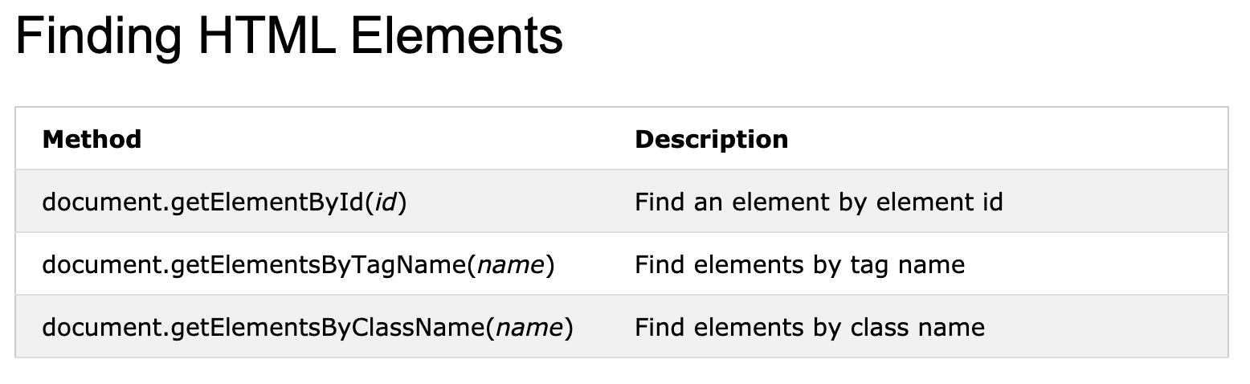
Document Object
?

Slide 34
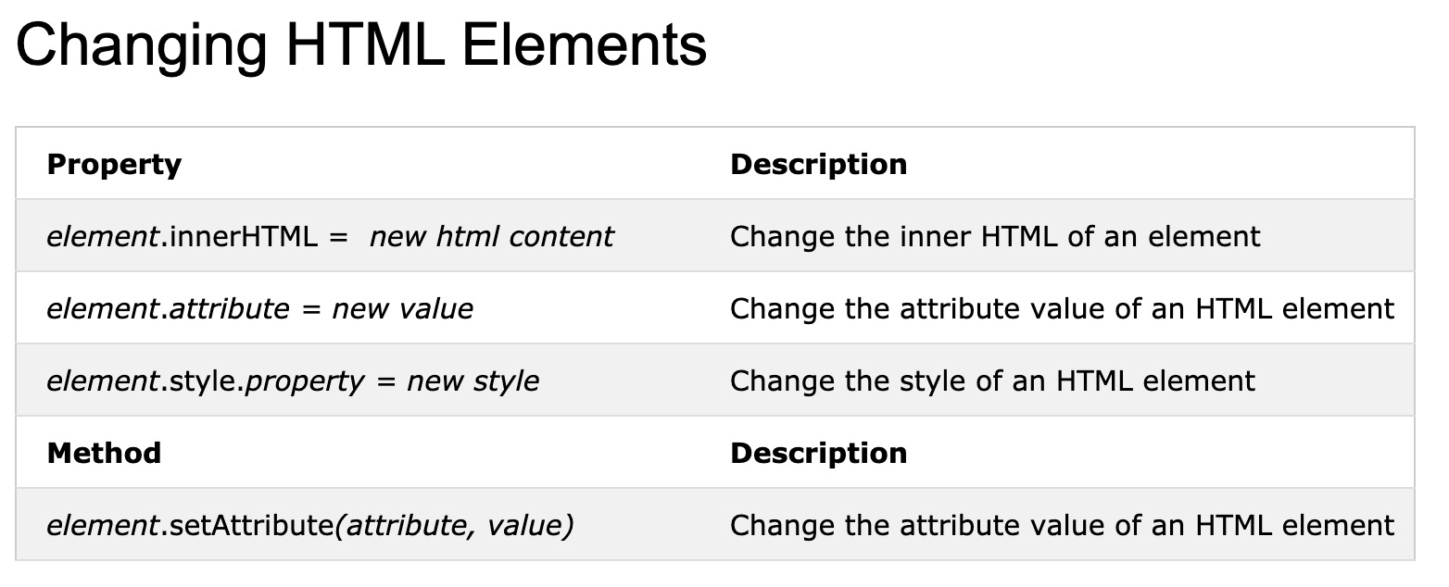
To Change

Slide 35
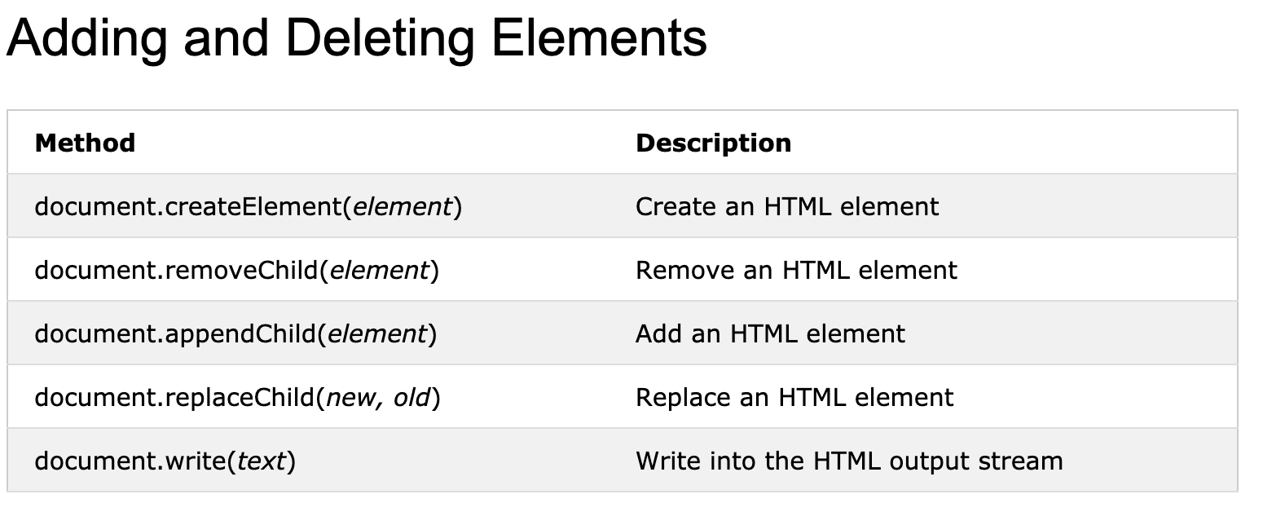
To add or delete

Slide 36
Function
Syntax:
function my_func () {
… // statements
}
function my_func (a) { …}
var my_func1 = function() { … };
*Arrow Function will be covered next week

Slide 37
How to bind a JS function to a button
<input id="clickMe" type="button" value="clickme" onclick=”my_func1();" />

Slide 38
Array
Simple form:
Same type of data
let donuts = [“apple fritter”, “double chocolate”, “maple dip”];
Diff type of data
let mixed = [5 , “hi”, true, undefined, null];
Arrays in arrays
let nested = [ [1,2,3], [“hello”, “hi”], [true] ];
Another form (using keyword “new”):
let data = new Array(1,2,3);
Not recommended, since potential confusion:
let data = new Array(30); // this is to create an array with 30 undefined

Slide 39
To Access one element in an array
Same as your Python,
to use [] with index (starting at zero)
For example,
var donuts = [“apple fritter”, “double chocolate”, “maple dip”];
console.log(donuts[2]); // will print: maple dip
console.log(donuts[4]); // will print: undefined

Slide 40
Array length
Arrays have length attribute by default, for the number of elements
For example,
let donuts = ["apple fritter", "double chocolate", "maple dip"];
console.log(donuts.length); // will print: 3
Your turn:
let nested = [ [1,2,3,4], ["hello", "hi"], [true, false] ];
console.log(nested.length);
Side note: strings in JS also have length

Slide 41
How to change an array (1/2)
To add new element into an array:
predefined method: push()
For example:
let grades = [ 99, 98, 97];
grades.push(100);
console.log(grades.length); // will print: 4
console.log(grades[3]); // will print: 100

Slide 42
How to change an array (2/2)
To remove one element from an array:
predefined method: pop()
For example:
let grades = [ 99, 98, 97];
grades.pop();
console.log(grades.length); // will print: 2
console.log(grades[2]); // will print: undefined

Slide 43
2D array
To define multi-dimensional arrays:
Same as nested arrays
For example:
let grades = [["Tom", 99], ["Sam", 98], ["Bob", 100]];
console.log(grades[0][0]); // will print: Tom
console.log(grades[1][1]); // will print: 98
Your turn:
if we want to print the 100, what we should put?
console.log(grades[ ? ][ ?]);

Slide 44
Loops
Just for repetition
For example,
To print "hello" 10 times
To print 1 to 100
To print all strings in an array

Slide 45
How to write a while loop
while (condition){ // condition for keep looping
… // loop body
}

Slide 46
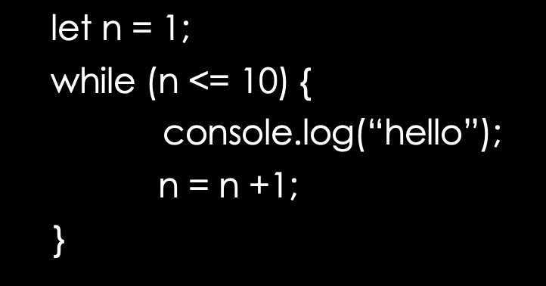
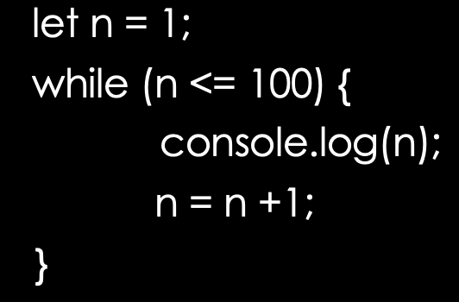
Examples of while loop
For example,
To print “hello” 10 times
To print 1 to 100
To print all strings in an array
let data = [“hi”, ”hello”, ”bye”];
let index = 0;
while (index < data.length) {
console.log(data[index]);
index = index +1;
}

Slide 47
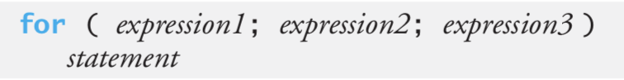
for loop
Use case #1:
Use case #2:
for ( expression1; expression2; expression3) {
statements
}
Use case #3:
for ( ; ; ) {
statements
}
Use case #4:
for ( expression1; expression2; expression3) ;

Slide 48
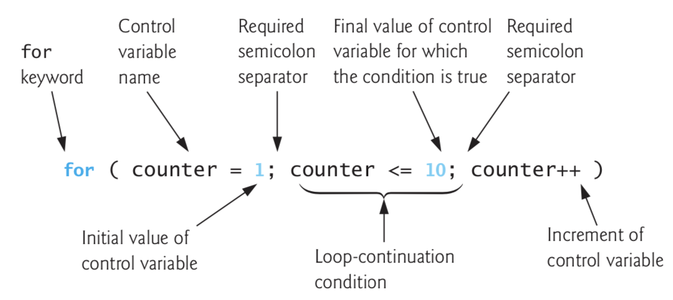
Anatomy

Slide 49
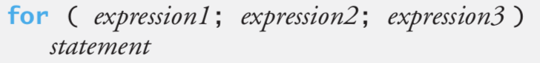
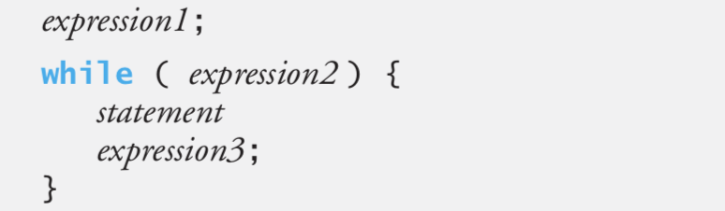
for loop V.S. while loop

Slide 50


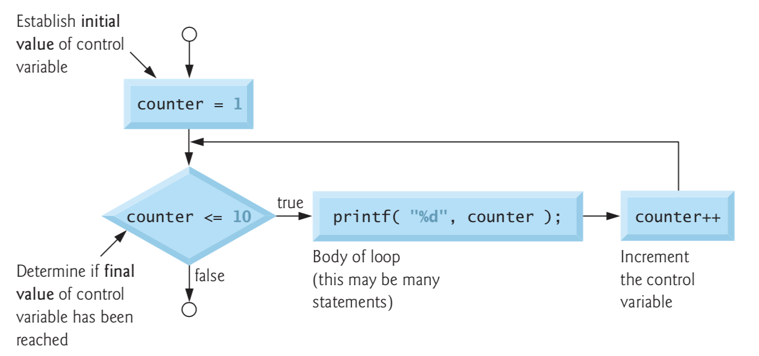
Flow chart

Slide 51
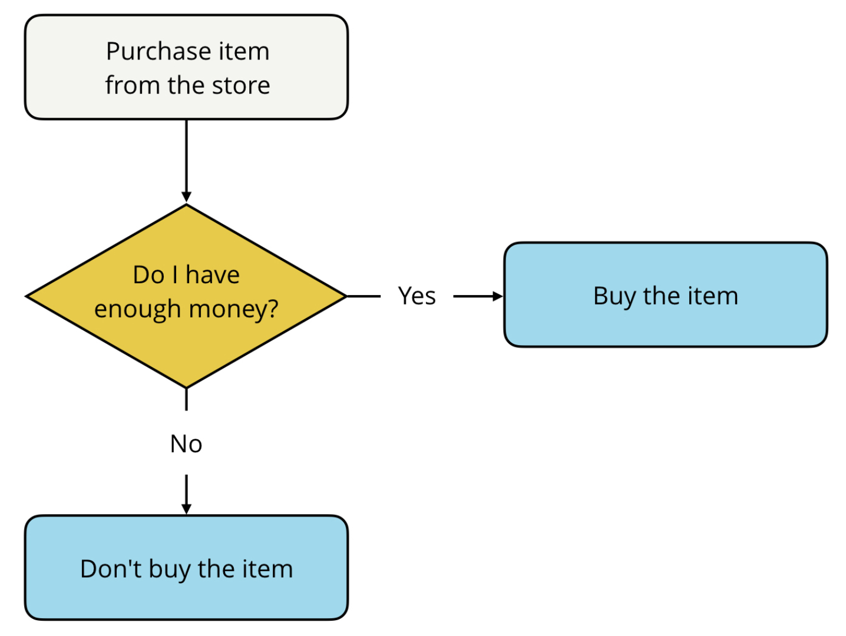
Conditionals

Slide 52
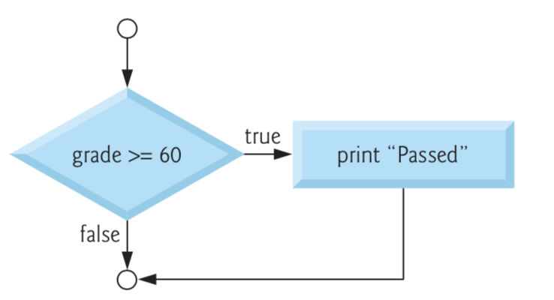
Basic if statement
(1)
if ( condition)
one statement; /* one statement to do when the condition got fulfilled */
(2)
if ( condition) {
statements /* one statement or statements to do when the condition got fulfilled */
}
Recommended

Slide 53
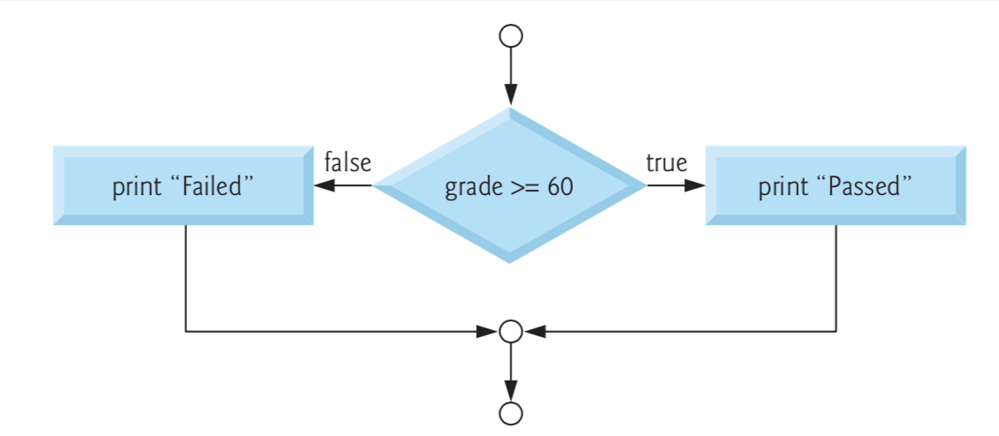
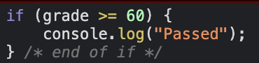
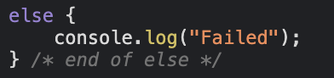
if-else statement

Slide 54
Shorter version of “if-else statement” Conditional operator ? :
Use case #1:
condition ? statement1 : statement 2 ;
Use case #2:
condition ? value1 : value 2 ;

Slide 55
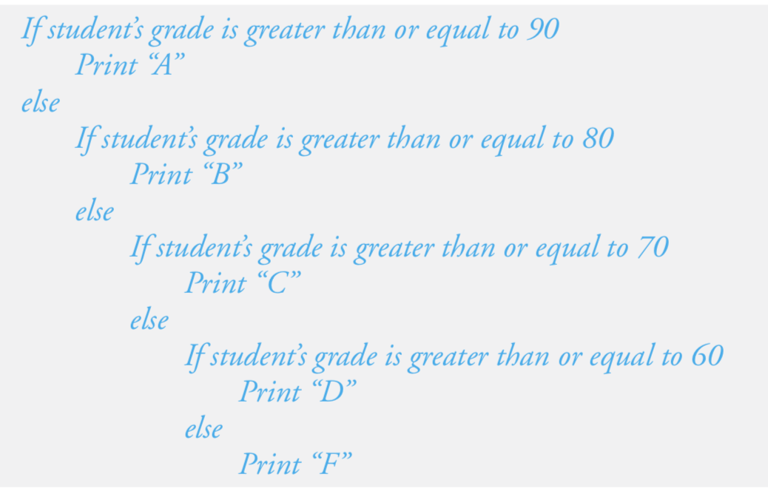
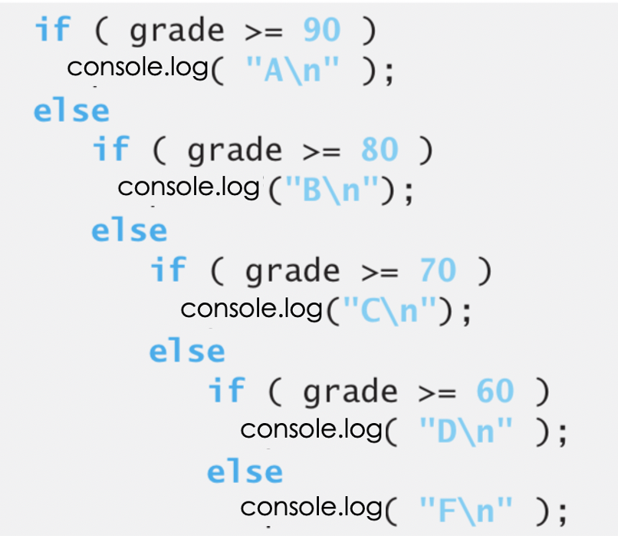
Nested if…else statement
Pseudocode
JS code

Slide 56
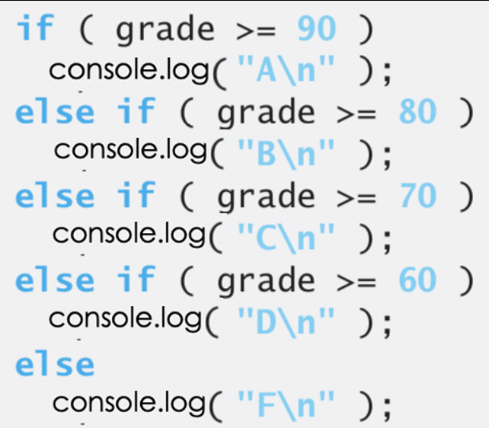
Nested if…else statement
Code using nested if…else statement
Code using if statement

Slide 57
More complex if statement
if (condition #1) {
one or more statements
}
else if (condition #2 ) {
one or more statements
}
else {
one or more statements
}
This part is called if-block
We can have one and only one if-block
This part is called else-if-block
We can have zero or more else-if-block
This part is called else-block
We can have zero or one else-block

Slide 58

ES6 covered in Lab 7
ECMA
Features in ES6:
Keywords: let and const
Destructuring
Arrow Functions
Default Parameters

